Slide 1



A Comprehensive Data Analysis on Medical Expenses
Medical Cost Analysis
Presentation
Vinit Solanki
Click here to watch video

Slide 2



Basic Statistics And Data Understanding
Overview of Key Metrics To gain an initial understanding of the dataset, we analyzed key statistical measures for BMI, Age, and Medical Charges. These metrics offer insights into the distribution and variability of health-related factors across individuals.
Average Values and Trends The average BMI is 30.66, indicating a trend toward overweight or obesity among individuals in the dataset. The average age is 39.21, showing a mix of younger and older individuals. Additionally, the average medical charges amount to $13,270.42, reflecting significant healthcare expenses.
Central Tendency and Dispersion The median values for BMI (30.4), age (39), and charges ($9,382.03) provide insights into the center of the data distribution. The standard deviation for BMI (6.10), age (14.05), and medical charges ($12,110.01) indicate considerable variation, particularly in medical costs where some individuals incur substantially higher expenses.
Key Observations The high standard deviation in medical charges suggests significant disparities in healthcare costs, likely influenced by factors such as chronic conditions, insurance coverage, or hospitalization needs. The relatively close values of average and median age indicate a balanced distribution across age groups. BMI levels further emphasize the importance of addressing weight-related health risks in the population.
Data Columns | AVG | Median | Stdev
Charges | 13279.12 | 9386.16 | 12110.36
BMI | 30.66 | 30.40 | 6.10
Age | 39.22 | 39.00 | 14.04

Slide 3
Gender-Based Analysis
Objective To compare the average medical charges and BMI between male and female beneficiaries.
Method Used AVERAGEIF and Pivot Table functions in Excel to calculate the average BMI and average medical charges for each gender.
Findings
Average BMI (Male): 30.94
Average BMI (Female): 30.38
Average Charges (Male): $13,975.00
Average Charges (Female): $12,569.58
Insights
Males have both higher average BMI and higher average medical charges compared to females.
The difference suggests a potential correlation between gender, BMI, and healthcare costs.
Row Labels | Average of bmi | Average of charges
female | 30.38 | 12569.58
male | 30.94 | 13975.00
Grand Total | 30.66 | 13279.12

Slide 4
Impact of Smoking on Medical Costs
Objective To evaluate how smoking status affects average medical charges among beneficiaries.
Method Used AVERAGEIFS and Pivot Table in Excel to calculate average charges separately for smokers and non-smokers.
Findings
Average Charges (Smokers): $32,050.23
Average Charges (Non-Smokers): $8,440.66
Insights
Smokers incur nearly 4 times higher average medical costs compared to non-smokers.
This significant cost difference highlights the financial burden of smoking-related health issues, making smoking a major risk factor in healthcare expenses.

Slide 5
Dependents Analysis
Objective To evaluate whether the number of children or dependents influences medical charges among beneficiaries.
Method Used Excel’s CORREL function to measure the statistical relationship between children and charges. Created a line chart to visualize this trend.
Findings
Correlation coefficient between number of children and medical charges is 0.067, indicating a very weak positive relationship.
The chart shows no clear upward or downward trend, with medical charges fluctuating widely across all dependent levels.
Insights
There is no strong evidence that having more children significantly increases medical costs.
While a slight positive trend exists, it is statistically insignificant, suggesting that other factors (like smoking status, age, or chronic illness) may have a greater influence on charges.

Slide 6
Geographical Insights
Objective To identify which U.S. region has the highest average medical charges and BMI among beneficiaries.
Method Used Excel Pivot Table and AVERAGEIFS to calculate average charges and BMI by region. A bar chart was created for visual comparison.
Findings
Southeast region has the highest average medical charges at $14,735.41
It also records the highest average BMI of 33.36
Southwest has the lowest average charges at $12,346.94
Insights
The Southeast region stands out with both elevated BMI and higher healthcare costs, indicating a potential regional health risk pattern.
This suggests that geographic location may influence both lifestyle and medical expenditures, which could be useful for targeted public health interventions.

Slide 7
Cost Distribution Analysis
Objective To understand how medical charges are distributed across beneficiaries and identify the most common cost bracket.
Method Used Excel’s Histogram tool via the Data Analysis Toolpak along with the FREQUENCY function to group charges into defined bin ranges.
Findings
The most common cost bracket is $0–10,000, with 711 beneficiaries falling in this range.
Frequency decreases significantly as charges increase:
$10,001–20,000: 352
$20,001–30,000: 111
Above $30,000: progressively fewer cases, only 3 above $70,000
Insights
The data is right-skewed, with most beneficiaries incurring lower medical expenses.
A small number of high-cost individuals create a long tail in the distribution, likely due to critical illnesses or hospitalization.

Slide 8
BMI Classification
Objective To categorize beneficiaries based on their BMI values and evaluate the distribution of weight categories within the dataset.
Method Applied Excel’s COUNTIFS and VLOOKUP with range-based lookup to classify BMI into four categories: Underweight, Normal, Overweight, and Obese.
Findings
Underweight (<18.5): 20 beneficiaries
Normal (18.5–24.9): 225 beneficiaries
Overweight (25–29.9): 386 beneficiaries
Obese (30+): 706 beneficiaries
Insights
A majority (706 individuals) fall into the Obese category, followed by those who are Overweight.
Only a small portion of the population is classified as Underweight or Normal, indicating a potential public health concern related to high BMI levels.
These insights may support initiatives focused on obesity prevention and management.

Slide 9
Advanced Correlation Analysis
Objective To assess the relationship between BMI and medical charges using a scatter plot and trendline.
Method Created a scatter plot in Excel with BMI on the x-axis and medical charges on the y-axis. Added a linear trendline and calculated correlation using the CORREL function.
Findings
Correlation coefficient between BMI and medical charges is 0.198, indicating a weak positive relationship.
The trendline shows a slight upward slope, suggesting that higher BMI is generally associated with increased medical costs.
Insights
While the relationship is not strong, there is some evidence that higher BMI levels may contribute to elevated medical expenses.
This supports the need for preventive healthcare strategies targeting weight-related health risks.

Slide 10
Smoking and Region Interaction
Objective To explore how smoking status and geographical region together impact medical charges, and determine which region incurs the highest smoker-related costs.
Method Created a Pivot Table in Excel with region as row labels and smoking status as a filter. Used AVERAGEIFS and slicers to isolate charges for smokers only.
Findings
Southeast region shows the highest total medical charges for smokers at $3,170,894.71
Other regions rank as follows:
Northeast: $1,988,126.94
Southwest: $1,871,605.68
Northwest: $1,751,136.19
Insights
Smokers in the Southeast region account for a significantly larger share of healthcare expenses.
This may reflect regional health behaviors, access to care, or prevalence of smoking-related conditions.
Insights like these can help target regional anti-smoking campaigns or healthcare resource planning.
Sum of charges | Column Labels
Row Labels | yes
northeast | 1988126.944
northwest | 1751136.185
southeast | 3170894.711
southwest | 1871605.683
Grand Total | 8781763.522

Slide 11


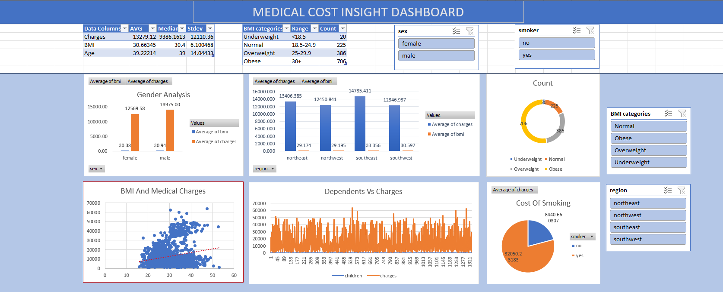
Dashboard for Stakeholders
-

Slide 12
Thank you
Data Speaks. Insights Lead.
-

